Slide 1
LESSON
7-1
Buying Plant Assets
Learning Objective
LO1 Journalize the purchase of plant assets.
© 2015 Cengage Learning. All Rights Reserved.

Slide 2
Plant Asset Costs
Lesson 7-1
LO1
Cash and other assets expected to be exchanged for cash or consumed within a year are called current assets.
Assets that will be used for a number of years in the operation of a business are known as plant assets.
Plant assets are sometimes referred to as fixed assets or long-term assets.
© 2015 Cengage Learning. All Rights Reserved.

Slide 3
Going Concern Concept and Depreciation
Lesson 7-1
LO1
Financial statements are prepared with the expectation that a business will remain in operation indefinitely.
The going concern concept enables a business to record the cost of plant assets on the balance sheet.
The cost of plant assets is recognized over many years through the recording of depreciation expense.
© 2015 Cengage Learning. All Rights Reserved.

Slide 4
What Costs Are Included in Plant Assets?
Lesson 7-1
LO1
All costs necessary to get the plant asset ready for its intended use are included in the cost of a plant asset.
For example:
LAND could include surveying and realtor fees
EQUIPMENT could include freight and installation
BUILDING could include costs like compliance with fire codes and accessibility laws
© 2015 Cengage Learning. All Rights Reserved.

Slide 5
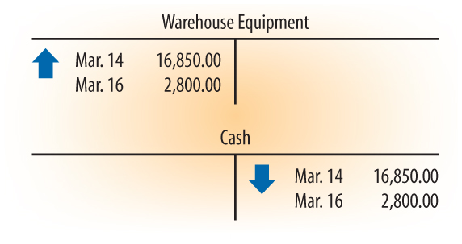
Buying a Plant Asset for Cash
Lesson 7-1
LO1
March 14. Paid cash to Metal Fabricators for a storage system, $16,850.00. Check No. 416.
March 16. Paid cash to Preston Construction to assemble the storage system, $2,800.00. Check No. 417.
1
Account Title
2
Cost of the Plant Asset
3
Cash Paid
© 2015 Cengage Learning. All Rights Reserved.

Slide 6
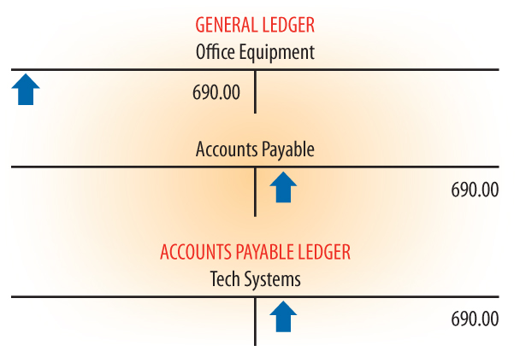
Buying a Plant Asset on Account
Lesson 7-1
LO1
March 6. Bought on account new monitors for three office computers from Tech Systems, $690.00. Memorandum No. 23.
Since this transaction does not involve the purchase of merchandise, the entry is not recorded in a purchases journal. Instead it is recorded in the general journal and posted to both the general ledger and the accounts payable ledger.
© 2015 Cengage Learning. All Rights Reserved.

Slide 7
Allocating the Cost of Plant Assets
Lesson 7-1
LO1
March 12. Purchased a distribution center from NexTra Industries, signing a 10-year note. Memorandum No. 26.
© 2015 Cengage Learning. All Rights Reserved.

Slide 8
Allocating the Cost of Plant Assets
Lesson 7-1
LO1
Calculate the cost assigned to each asset purchased:
© 2015 Cengage Learning. All Rights Reserved.

Slide 9
Recording the Buying of a Group of Assets
Lesson 7-1
LO1
Calculate the cost assigned to the Land (Asset 1):
© 2015 Cengage Learning. All Rights Reserved.

Slide 10
Recording the Buying of a Group of Assets
Lesson 7-1
LO1
Calculate the cost assigned to the Building (Asset 2):
Estimated Value of Building | ÷ | Total Estimated Value of All Assets Bought | = | Percentage of Total Estimated Value
$240,000 | ÷ | $300,000 | = | 80%
Total Purchase Price | ÷ | Percentage of Total Estimated Value | = | Cost Assigned to Building
$280,000 | ÷ | 80% | = | $224,000
© 2015 Cengage Learning. All Rights Reserved.

Slide 11
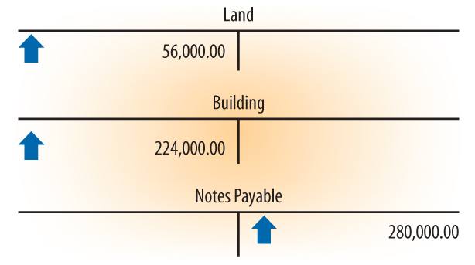
Recording the Buying of a Group of Assets
Lesson 7-1
LO1
March 12. Purchased a distribution center from NexTra Industries, signing a 10-year note. Memorandum No. 26.
1
Account Title for First Plant Asset
2
Amount Assigned to Asset 1
3
Account Title for Second Plant Asset
4
Amount Assigned to Asset 2
Total Cost
5
© 2015 Cengage Learning. All Rights Reserved.

Slide 12
International Accounting Standards
Lesson 7-1
LO1
June 7. Bethune Company pays cash for a $30,000.00 delivery truck. Check No. 523.
IFRS recognize that components of a single plant asset may be used by the business for different periods of time.
© 2015 Cengage Learning. All Rights Reserved.

Slide 13
Preparing Plant Asset Records
Lesson 7-1
LO1
An accounting form on which a business records information about each plant asset is called a plant asset record.
© 2015 Cengage Learning. All Rights Reserved.

Slide 14
Content of Plant Asset Records
Lesson 7-1
LO1
Most plant asset records contain similar information.
Section 1 is prepared when a plant asset is bought.
Section 2 provides space for recording the disposition of the plant asset. When the asset is disposed of, this information will be filled in.
Section 3 provides space for recording annual depreciation expense and the changing book value of the asset each year it is used.
© 2015 Cengage Learning. All Rights Reserved.

Slide 15
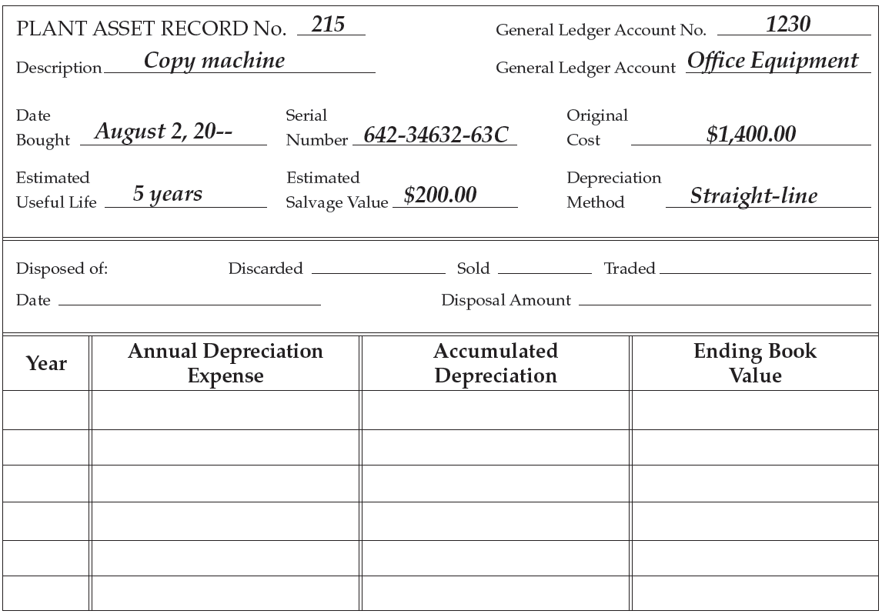
Preparing Plant Asset Records
Lesson 7-1
LO1
Completed when asset is purchased.
1
Completed when asset is disposed of.
2
3
Completed each year to record depreciation.
© 2015 Cengage Learning. All Rights Reserved.

Slide 16
Calculating and Paying Property Tax
Lesson 7-1
LO1
Land and anything attached to the land is called real property.
Real property is sometimes referred to as real estate.
All property not classified as real property is called personal property.
The value of an asset determined by tax authorities for the purpose of calculating taxes is called the assessed value.
The tax rate used to calculate property taxes is called a millage rate.
© 2015 Cengage Learning. All Rights Reserved.

Slide 17
Lesson 7-1 Audit Your Understanding
Lesson 7-1
1. What costs are included in the cost of a plant asset?
ANSWER
All costs necessary to get the plant asset ready for its intended use are included in the cost of a plant asset.
© 2015 Cengage Learning. All Rights Reserved.
© 2015 Cengage Learning. All Rights Reserved.

Slide 18
Lesson 7-1 Audit Your Understanding
Lesson 7-1
2. How is the cost assigned to plant assets purchased as a group?
ANSWER
The cost is allocated to individual plant assets based on their appraised values.
© 2015 Cengage Learning. All Rights Reserved.
© 2015 Cengage Learning. All Rights Reserved.

Slide 19
Lesson 7-1 Audit Your Understanding
Lesson 7-1
3. How is the purchase of plant assets accounted for using IFRS?
ANSWER
Components of the plant asset having different useful lives are assigned a cost and recorded in different plant asset accounts.
© 2015 Cengage Learning. All Rights Reserved.
© 2015 Cengage Learning. All Rights Reserved.

Slide 20
Lesson 7-1 Audit Your Understanding
Lesson 7-1
4. What are the three sections of a plant asset record?
ANSWER
a. General information completed when the asset is purchased.
b. Disposal section completed when the asset is discarded, sold, or traded.
c. Section to record annual depreciation
expense.
© 2015 Cengage Learning. All Rights Reserved.
© 2015 Cengage Learning. All Rights Reserved.

Slide 21
Lesson 7-1 Audit Your Understanding
Lesson 7-1
5. How is the amount of property tax determined?
ANSWER
The assessed value of the property is multiplied by the millage rate of the governmental unit.
© 2015 Cengage Learning. All Rights Reserved.
© 2015 Cengage Learning. All Rights Reserved.

