Slide 1
LESSON
7-2
Calculating and
Journalizing
Depreciation Expense
Learning Objectives
LO2 Calculate and record depreciation expense using straight-line depreciation.
© 2015 Cengage Learning. All Rights Reserved.

Slide 2
Factors Used to Calculate Depreciation
Lesson 7-2
LO2
The portion of a plant asset’s cost that is transferred to an expense account in each fiscal period during a plant asset’s useful life is called depreciation expense.
Three factors are used to calculate a plant asset’s annual depreciation expense:
Original cost—the original cost of a plant asset includes all costs paid to make the asset usable to a business.
Estimated salvage value—the estimated salvage value is the amount that will be received for an asset at the time of its disposal (also called residual value, scrap value, or trade-in value).
Estimated useful life—the number of years it is expected to be useful to a business.
© 2015 Cengage Learning. All Rights Reserved.
© 2015 Cengage Learning. All Rights Reserved.

Slide 3
Calculating Straight-Line Depreciation
Lesson 7-2
LO2
Recording an equal amount of depreciation expense for a plant asset in each year of its useful life is called the straight-line method of depreciation.
On January 2, 20X1, Vaughn Distributors bought a computer for $4,000.00 with an estimated salvage value of $1,000.00 and an estimated useful life of five years.
Original Cost | − | Estimated Salvage Value | = | Estimated Total Depreciation Expense
$4,000.00 | − | $1,000.00 | = | $3,000.00
Estimated Total Depreciation Expense | ÷ | Years of Estimated Useful Life | = | Annual Depreciation Expense
$3,000.00 | ÷ | 5 | = | $600.00
© 2015 Cengage Learning. All Rights Reserved.

Slide 4
Calculating Book Value
Lesson 7-2
LO2
The original cost of a plant asset minus accumulated depreciation is called the book value of a plant asset.
Original Cost | − | Annual Depreciation | = | Ending Book Value After Year 1
$2,800.00 | − | $600.00 | = | $2,200.00
© 2015 Cengage Learning. All Rights Reserved.

Slide 5
Calculating Depreciation Expense for Part of a Year
Lesson 7-2
LO2
Annual Depreciation Expense | ÷ | Months in Year | = | Monthly Depreciation Expense
$240.00 | ÷ | 12 | = | $20.00
Monthly Depreciation Expense | × | Number of Months Asset Is Used | = | Partial Year’s Depreciation Expense
$20.00 | × | 5 | = | $100.00
© 2015 Cengage Learning. All Rights Reserved.

Slide 6
Alternate Methods For Partial-Year Depreciation
Lesson 7-2
LO2
A method that recognizes one half of a year’s depreciation in the year of acquisition is called the half-year convention.
A method that recognizes a full year’s depreciation if the asset is acquired in the first half of the year is called the modified half-year convention.
Whatever method a business selects, it should be used consistently from year to year.
© 2015 Cengage Learning. All Rights Reserved.

Slide 7
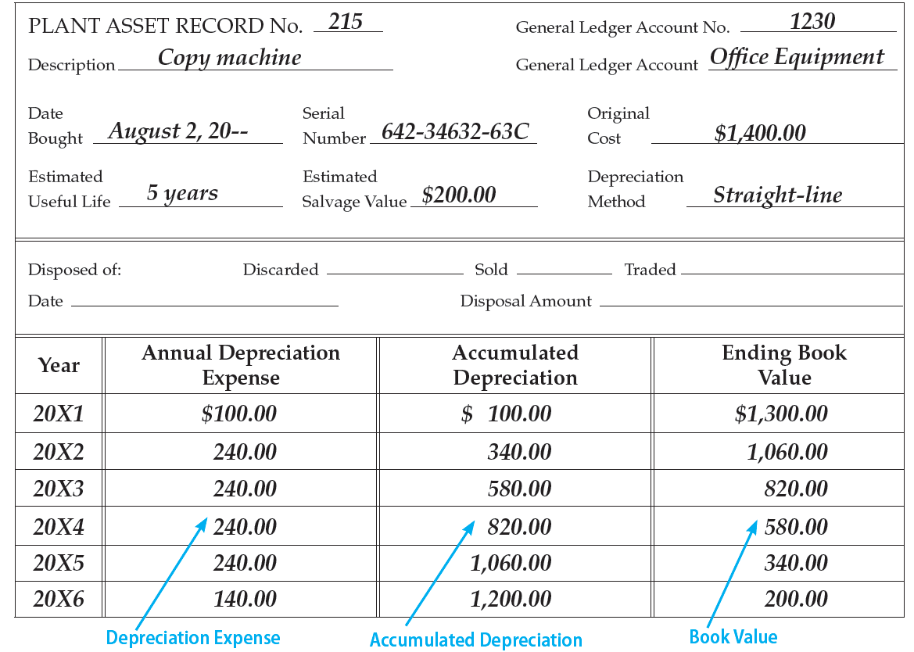
Recording Depreciation on Plant Asset Records: Example
Lesson 7-2
LO2
© 2015 Cengage Learning. All Rights Reserved.
© 2015 Cengage Learning. All Rights Reserved.

Slide 8
Calculating Accumulated Depreciation
Lesson 7-2
LO2
Based on the previous example:
20X3 Depreciation Expense | + | 20X2 Accumulated Depreciation | = | 20X3 Accumulated Depreciation
$240.00 | + | $340.00 | = | $580.00
© 2015 Cengage Learning. All Rights Reserved.

Slide 9
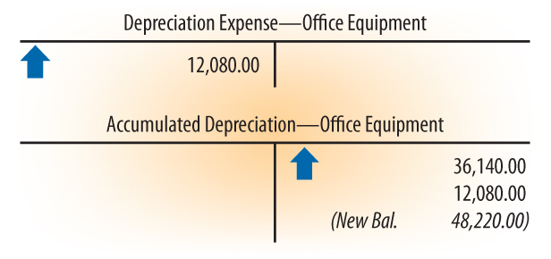
Journalizing Depreciation Expense
Lesson 7-2
LO2
1
Debit Depreciation Expense
2
Credit Accumulated Depreciation
© 2015 Cengage Learning. All Rights Reserved.

Slide 10
Journalizing Repair and Maintenance Payments
Lesson 7-2
LO2
When a long-term asset is purchased, it is recorded at its historical cost, the actual amount paid for the asset.
If the expenditure merely maintains the asset in its normal operation, it should be treated as an expense in the period the payment is made.
If the expenditure adds to the value or extends the useful life of the asset, it must be added to the cost of the asset instead of treated as an immediate expense.
© 2015 Cengage Learning. All Rights Reserved.

Slide 11
Lesson 7-2 Audit Your Understanding
Lesson 7-2
1. Which accounting concept is being applied when depreciation expense is recorded for plant assets?
ANSWER
Matching Expenses with Revenue.
© 2015 Cengage Learning. All Rights Reserved.
© 2015 Cengage Learning. All Rights Reserved.

Slide 12
Lesson 7-2 Audit Your Understanding
Lesson 7-2
2. Why is annual depreciation for land not recorded?
ANSWER
Because of its permanent nature, depreciation is not recorded for land.
© 2015 Cengage Learning. All Rights Reserved.
© 2015 Cengage Learning. All Rights Reserved.

Slide 13
Lesson 7-2 Audit Your Understanding
Lesson 7-2
3. What three factors are used to calculate a plant asset’s annual depreciation expense?
ANSWER
Original cost, estimated salvage value, and estimated useful life.
© 2015 Cengage Learning. All Rights Reserved.
© 2015 Cengage Learning. All Rights Reserved.

Slide 14
Lesson 7-2 Audit Your Understanding
Lesson 7-2
4. Should the installation of an elevator in a retail store be accounted for as a repair or an addition to the historical cost of the building?
ANSWER
The cost of the elevator should be added to the historical cost of the building. The addition adds to the value of the building.
© 2015 Cengage Learning. All Rights Reserved.
© 2015 Cengage Learning. All Rights Reserved.

Slide 15
Lesson 7-2 Audit Your Understanding
Lesson 7-2
5. What is the smallest unit of time used to calculate depreciation?
ANSWER
A calendar month.
© 2015 Cengage Learning. All Rights Reserved.
© 2015 Cengage Learning. All Rights Reserved.

