Slide 1
LESSON
7-3
Disposing of Plant
Assets
Learning Objective
LO3 Journalize the disposal of plant assets.
© 2015 Cengage Learning. All Rights Reserved.

Slide 2
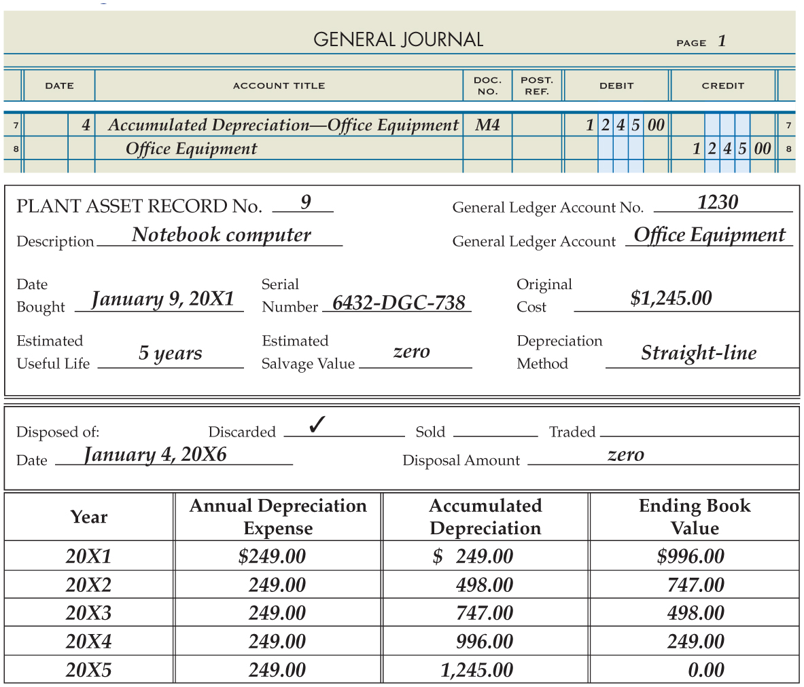
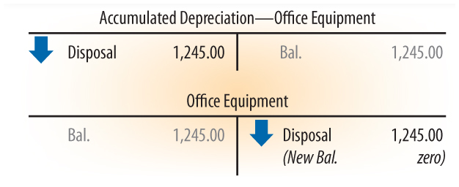
Discarding a Plant Asset with No Book Value
Lesson 7-3
January 4, 20X6. Discarded a notebook computer: original cost, $1,245.00; total accumulated depreciation through December 31, 20X5, $1,245.00. Memorandum No. 4.
LO3
1
Journalize disposal.
2
Date, Amount, and Type of Disposal.
© 2015 Cengage Learning. All Rights Reserved.
© 2015 Cengage Learning. All Rights Reserved.

Slide 3
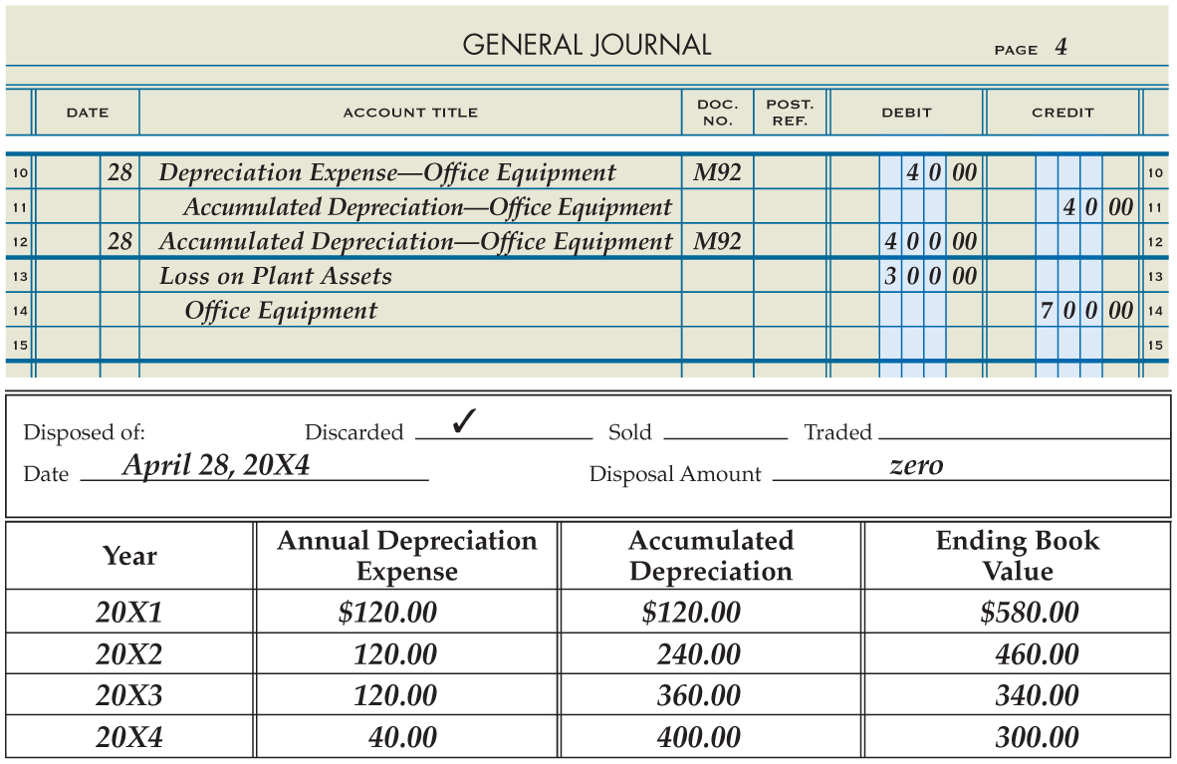
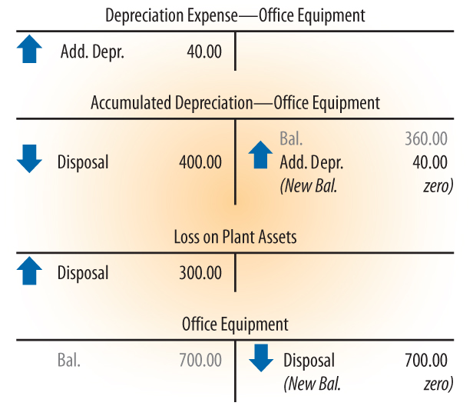
Discarding a Plant Asset with Book Value
Lesson 7-3
April 28, 20X4. Discarded office table: original cost, $700.00; total accumulated depreciation through December 31, 20X3, $360.00; additional depreciation to be recorded through April 28, 20X4, $40.00. Memorandum No. 92.
LO3
1
Journalize Partial Year’s Depreciation
4
Journalize Disposal
3
Date, Amount, and Type of Disposal.
2
Partial Year’s Depreciation
© 2015 Cengage Learning. All Rights Reserved.
© 2015 Cengage Learning. All Rights Reserved.

Slide 4
Selling a Plant Asset
Lesson 7-3
LO3
When a plant asset is sold, a journal entry is recorded to:
Remove the original cost of the plant asset and its related accumulated depreciation.
Recognize the cash received.
Recognize the gain or loss on disposal of the asset.
© 2015 Cengage Learning. All Rights Reserved.
© 2015 Cengage Learning. All Rights Reserved.

Slide 5
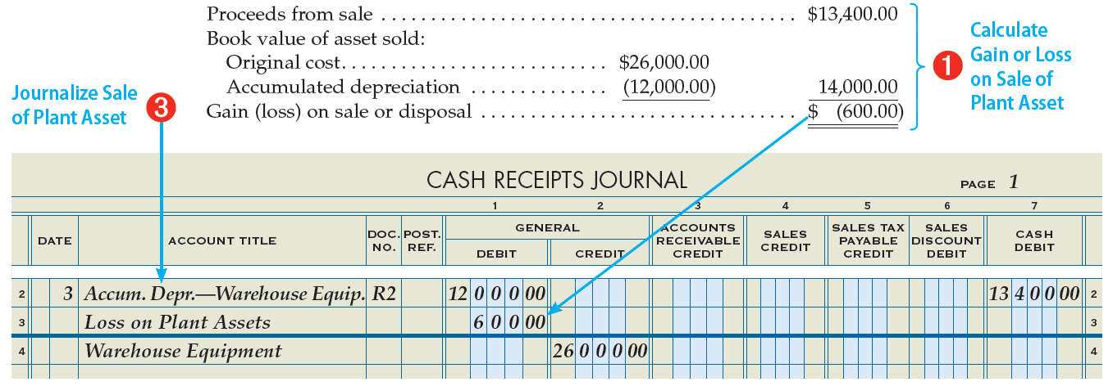
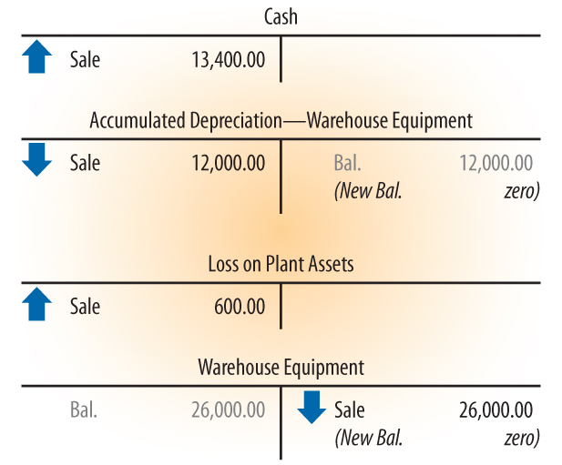
Selling a Plant Asset
Lesson 7-3
January 3, 20X4. Received cash from sale of a packing machine, $13,400.00; original cost, $26,000.00; total accumulated depreciation through December 31, 20X3, $12,000.00. Receipt No. 2.
LO3
© 2015 Cengage Learning. All Rights Reserved.
© 2015 Cengage Learning. All Rights Reserved.

Slide 6
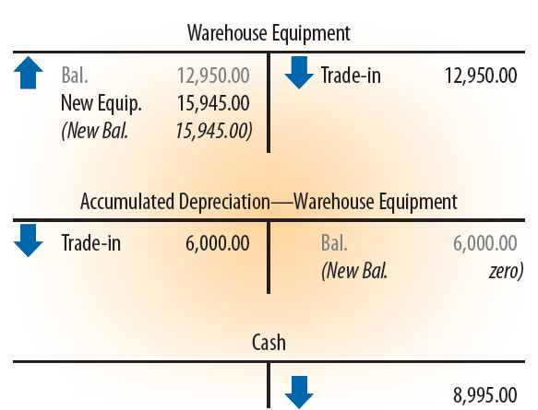
Trading a Plant Asset
Lesson 7-3
LO3
When an old plant asset is traded for a new plant asset, the journal entry:
Removes the original cost of the old plant asset and its related accumulated depreciation.
Recognizes the cash paid.
Records the new plant asset at its original cost.
December 20, 20X5. Paid cash, $8,995.00, plus old forklift for new forklift: original cost of old forklift, $12,950.00; total accumulated depreciation through December 20, 20X5, $6,000.00. Check No. 848.
© 2015 Cengage Learning. All Rights Reserved.
© 2015 Cengage Learning. All Rights Reserved.

Slide 7
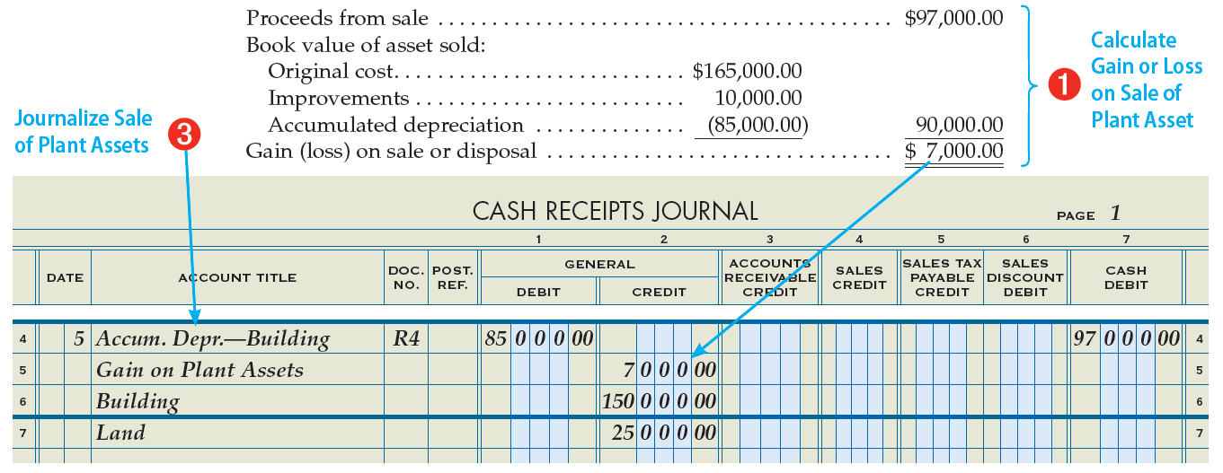
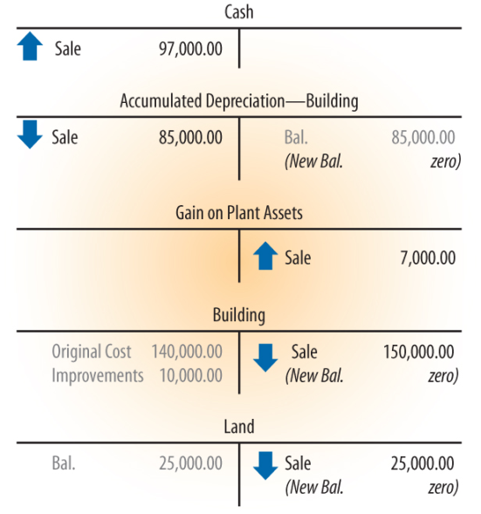
Selling Land and Buildings
Lesson 7-3
January 5, 20X6. Fidelity Company sold land with a building for $97,000.00 cash; original cost of land, $25,000.00; original cost of building, $140,000.00; improvements to prepare the building for sale, $10,000.00; total accumulated depreciation on building through December 31, 20X5, $85,000.00. Receipt No. 4.
LO3
© 2015 Cengage Learning. All Rights Reserved.
© 2015 Cengage Learning. All Rights Reserved.

Slide 8
Lesson 7-3 Audit Your Understanding
Lesson 7-3
1. What is recorded on a plant asset record for a plant asset that has been discarded?
ANSWER
The date, type, and amount of disposal.
© 2015 Cengage Learning. All Rights Reserved.
© 2015 Cengage Learning. All Rights Reserved.

Slide 9
Lesson 7-3 Audit Your Understanding
Lesson 7-3
2. When an asset is disposed of after the beginning of the fiscal year, what entry may need to be recorded before an entry is made for a discarded plant asset?
ANSWER
Depreciation Expense will be debited and Accumulated Depreciation will be credited to bring the accounts up to date before the disposal.
© 2015 Cengage Learning. All Rights Reserved.
© 2015 Cengage Learning. All Rights Reserved.

Slide 10
Lesson 7-3 Audit Your Understanding
Lesson 7-3
3. What is the formula to compute the gain or loss on the sale of a plant asset?
ANSWER
Cash received minus the book value of the asset sold.
© 2015 Cengage Learning. All Rights Reserved.
© 2015 Cengage Learning. All Rights Reserved.

Slide 11
Lesson 7-3 Audit Your Understanding
Lesson 7-3
4. When cash is paid and old store equipment is traded for new store equipment, what is the formula for calculating the new equipment’s original cost?
ANSWER
Cash plus the book value of the store equipment traded equals the book value of the new store equipment.
© 2015 Cengage Learning. All Rights Reserved.
© 2015 Cengage Learning. All Rights Reserved.

