Slide 1
Maintaining A Checking Account
Mrs. Malsky

Slide 2
Check
Oct. 26 11
Knoxville Utility District
22.18
Twenty – two and 18/100 --------------------------
Utility Bill
Amanda Malsky

Slide 3
Check Register
822 33
302
10/26
Knoxville Utility District
22 18
22 18
Sept. Payment
800 15
303
10/28
Linden’s Supermarket
35 90
35 90
Groceries
764 25
304
10/29
Turnell Realty
575 00
575 00
Rent
189 25

Slide 4
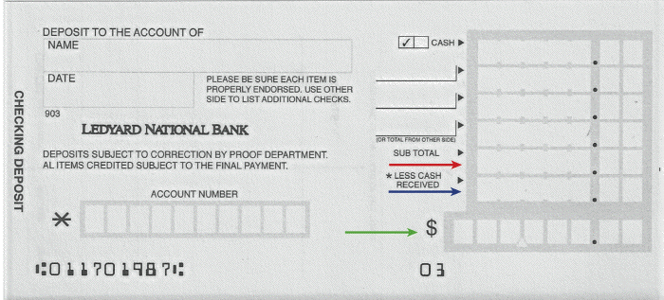
Deposit Slip
Laura Kaplan
14 5 0
97-833
98 0 0
Oct 31, 2011
34-688
27 5 0
140 0 0
0 0 0
1 4 0 0 0

Slide 5
Check Register
822 33
302
10/26
Knoxville Utility District
22 18
22 18
Sept. Payment
800 15
303
10/28
Linden’s Supermarket
35 90
35 90
Groceries
764 25
304
10/29
Turnell Realty
575 00
575 00
Rent
189 25
---
10/31
Deposit
140 00
140 00
Paycheck & Gifts
329 25

Slide 6
Why Reconcile??
Extra Practice Problem 1
Bank Balance: $275.38
Check Register Balance: $368.85

Slide 7
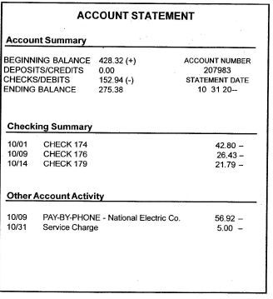
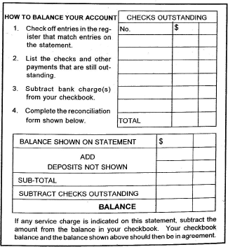

Slide 8
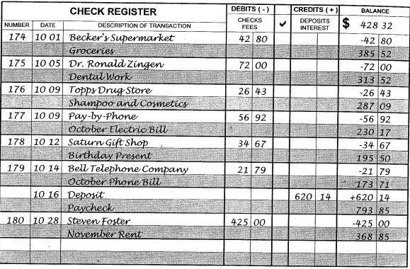
Check off entries for Checks
Check off entries for Other Activity
Check off entries for Deposits

Slide 9
175 72 00
178 34 67
180 425 00
531 67
10/31
Service Charge
5 00
- 5 00
363 85
Subtract the service charge
Enter the checks outstanding

Slide 10
175 72 00
178 34 67
180 425 00
f
531 67
275 38
620 14
895 52
531 67
363 85
10/31
Service Charge
5 00
- 5 00
363 85
Enter ending balance
Enter deposits outstanding

Slide 11
175 72 00
178 34 67
180 425 00
531 67
275 38
620 14
895 52
531 67
363 85
10/31
Service Charge
5 00
- 5 00
363 85

