Slide 1
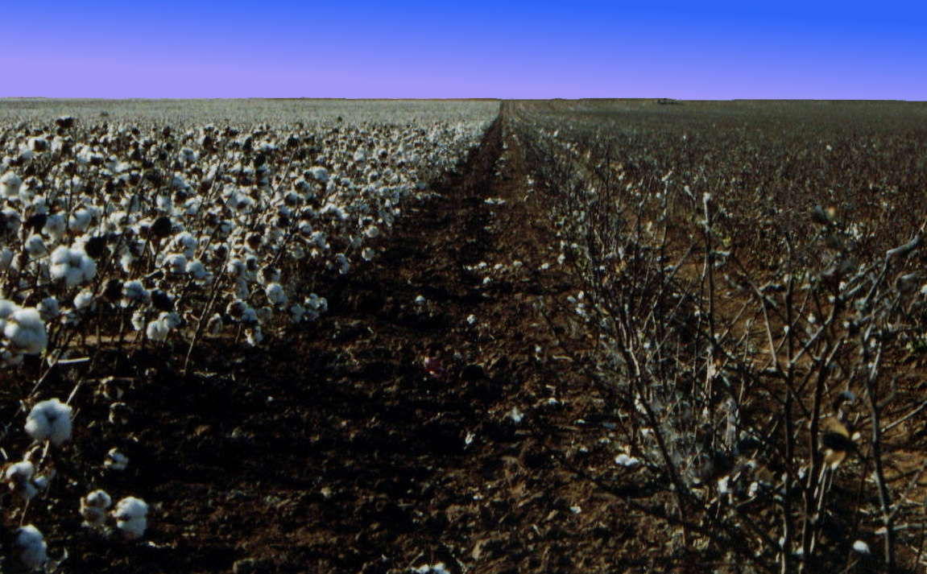
C O T T O N
C O T T O N
THE STORY OF
C O T T O N
C O T T O N

Slide 2
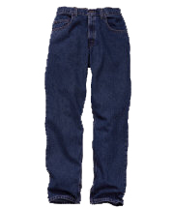
How do they make…?
Jeans
Sheets
Shirts

Slide 3
Basic Facts
Cotton is a plant
It grows wild in many places on the earth
Has been known cultivated and used by people of many lands for centuries
Cotton needs lots of sunshine, water and fertile soil
The boll weevil is the primary insect enemy of cotton

Slide 4
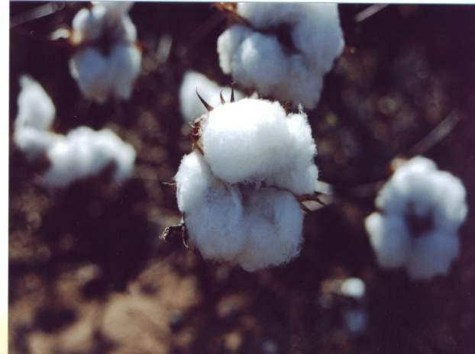
Types of Cotton
Egyptian
Sea Island
American Pima
Asiatic
Upland

Slide 5
People in History
Lewis Paul and John Wyatt
  Roller spinning machine 1738
Samuel Slater
  First US. cotton mill 1790
Eli Whitney
  cotton gin in 1793

Slide 6
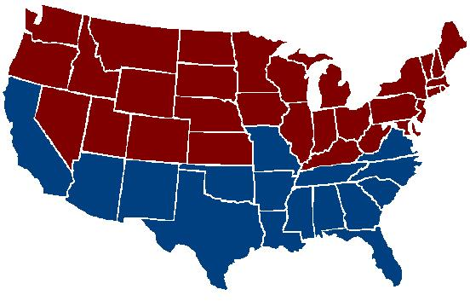
The Cotton Belt
Millions of acres of cotton grow across the Southern United States

Slide 7
Where Does Cotton Grow?

Slide 8
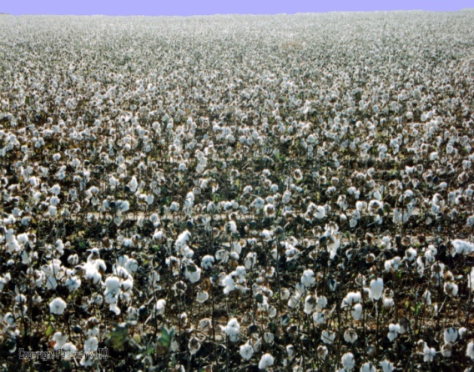
US Cotton States
Alabama
Arizona
Arkansas
California
Georgia
Louisiana
Mississippi
Missouri
North Carolina
Oklahoma
South Carolina
Tennessee
Texas
Virginia
Upland cotton

Slide 9
US Cotton States
Arizona
California
New Mexico
Texas
Pima cotton
Some cotton is also grown in Florida, Kansas and New Mexico.

Slide 10
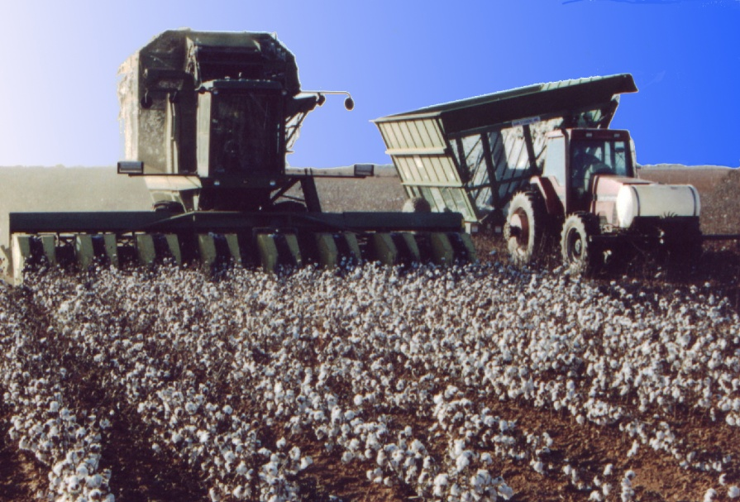
Leading Cotton Production
Texas, which annually grows about 4.5 million bales of cotton, is the leading cotton producing state.

Slide 11
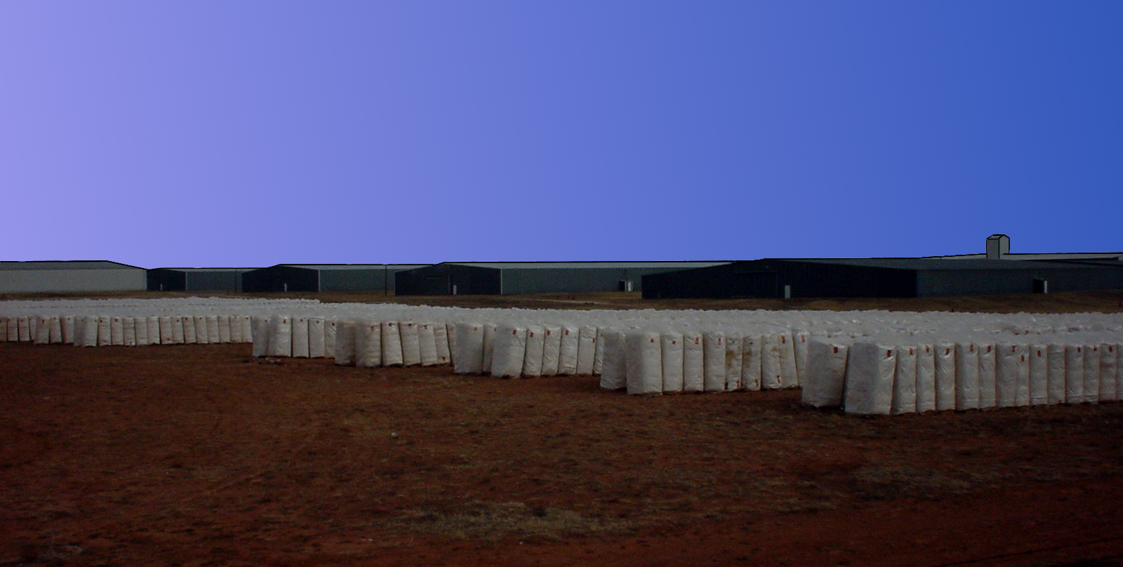

Slide 12
A Bale of Cotton
55 inches tall
28 inches wide
21 inches thick
500 pounds
313,600 $100 bills
215 Jeans
249 Bed Sheets
690 Bath Towels
1,217 Men's T-Shirts
1,256 Pillowcases
1,085 Diapers

Slide 13
Cotton Production in Millions of Bales

Slide 14
Products and Byproducts of Cotton

Slide 15
Cottonseed Oil

Slide 16
The End

