Slide 1
LESSON
7-4
Other Methods of
Depreciation
Learning Objectives
LO4 Calculate depreciation expense using the declining-balance depreciation method.
LO5 Calculate depreciation expense using the units-of-production method.
LO6 Calculate and record depletion of a natural resource.
© 2015 Cengage Learning. All Rights Reserved.

Slide 2
Declining-Balance Method of Depreciation
Lesson 7-4
LO4
Any method of depreciation that records greater depreciation expense in the early years and less depreciation expense in the later years is called accelerated depreciation.
The declining-balance method of depreciation is a type of accelerated depreciation that multiplies the book value of an asset by a constant depreciation rate to determine annual depreciation.
A declining-balance rate that is twice the straight-line rate is called the double declining-balance method of depreciation.
© 2015 Cengage Learning. All Rights Reserved.

Slide 3
Declining-Balance Method of Depreciation
Lesson 7-4
LO4
Estimated Depreciation Expense | ÷ | Years of Estimated Useful Life | = | Straight-Line Rate of Depreciation
100% | ÷ | 5 | = | 20%
Straight-Line Rate of Depreciation | × | Multiply by Two | = | Double Declining-Balance Rate of Depreciation
20% | × | 2 | = | 40%
© 2015 Cengage Learning. All Rights Reserved.

Slide 4
Declining-Balance Method of Depreciation
Lesson 7-4
LO4
Plant Asset: Automobile Original Cost: $35,000.00
Depreciation Method: Double Declining-Balance Estimated Salvage Value: $3,000.00
Estimated Useful Life: 5 years
Year | Beginning Book Value | Double Declining- Balance Rate | Annual Depreciation | Ending Book Value
1 | $35,000.00 | 40% | $14,000.00 | $21,000.00
2 | 21,000.00 | 40% | 8,400.00 | 12,600.00
3 | 12,600.00 | 40% | 5,040.00 | 7,560.00
4 | 7,560.00 | 40% | 3,024.00 | 4,536.00
5 | 4,536.00 | — | 1,536.00 | 3,000.00
Total Depreciation |  |  | $32,000.00
1
2
Annual depreciation
3
Final year’s depreciation
Double declining-balance rate
© 2015 Cengage Learning. All Rights Reserved.

Slide 5
Units-of-Production Method of Depreciation
Lesson 7-4
LO5
Plant Asset: Van Original Cost: $24,200.00
Depreciation Method: Units-of-Production Estimated Salvage Value: $5,000.00
Original Cost: $24,200.00 Estimated Useful Life: 120,000 miles
Depreciation Rate: $0.16 per mile driven
Year | Beginning Book Value | Miles Driven | Annual Depreciation | Ending Book Value
1 | $24,200.00 | 22,600 | $3,616.00 | $20,584.00
2 | 20,584.00 | 24,300 | 3,888.00 | 16,696.00
3 | 16,696.00 | 28,100 | 4,496.00 | 12,200.00
4 | 12,200.00 | 20,400 | 3,264.00 | 8,936.00
5 | 8,936.00 | 16,200 | 2,592.00 | 6,344.00
1
Annual depreciation
expense
2
Unit depreciation
rate
© 2015 Cengage Learning. All Rights Reserved.

Slide 6
Units-of-Production Method of Depreciation
Lesson 7-4
LO5
Original Cost | - | Estimated Salvage Value | = | Total Depreciation Expense
$24,200 | - | $5,000 | = | $19,200
Total Depreciation Expense | ÷ | Estimated Useful Life | = | Unit Depreciation Rate
$19,200 | ÷ | 120,000 miles | = | $0.16/mile
© 2015 Cengage Learning. All Rights Reserved.

Slide 7
Calculating Depreciation Expense for Income Tax Reporting
Lesson 7-4
LO5
The U.S. Internal Revenue Service has published rules for most plant assets when calculating the amount of depreciation expense used in computing a business’s federal income tax obligation.
This depreciation method is called the Modified Accelerated Cost Recovery System (MACRS).
MACRS is an accelerated depreciation method with prescribed periods for nine classes of plant assets.
© 2015 Cengage Learning. All Rights Reserved.

Slide 8
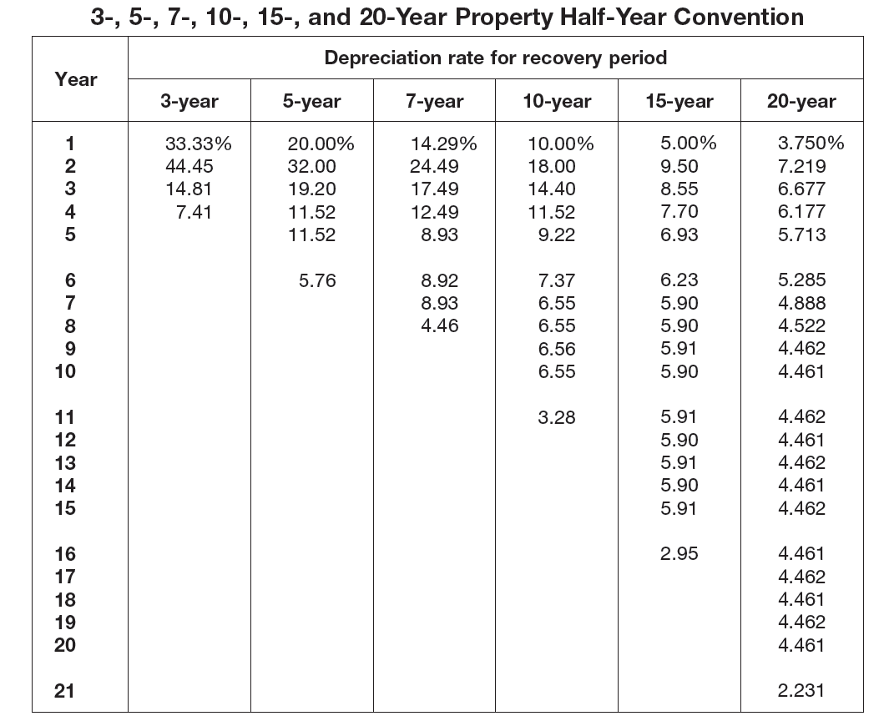
MACRS Table
Lesson 7-4
LO5
© 2015 Cengage Learning. All Rights Reserved.
© 2015 Cengage Learning. All Rights Reserved.

Slide 9
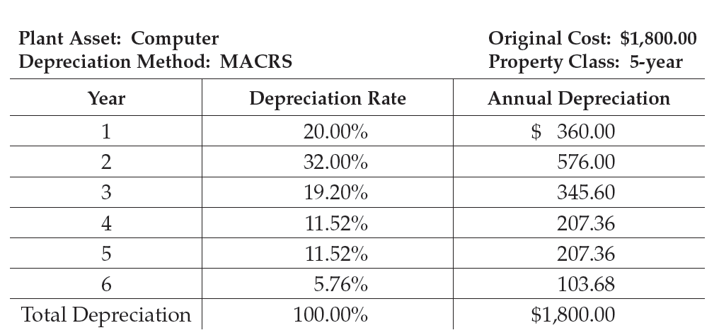
MACRS Example
Lesson 7-4
LO5
© 2015 Cengage Learning. All Rights Reserved.
© 2015 Cengage Learning. All Rights Reserved.

Slide 10
Comparison of Depreciation Methods
Lesson 7-4
LO5
Plant Asset: Automobile Original Cost: $4,000.00
Depreciation Method: Comparison of 5-year Property Estimated Salvage Value: $350.00
Estimated Useful Life: 5 years
 | Straight-Line Method | Double Declining-Balance Method | MACRS
Year | Annual Depreciation | Annual Depreciation | Annual Depreciation
1 | $730.00 | $1,600.00 | $800.00
2 | 730.00 | 960.00 | 1,280.00
3 | 730.00 | 576.00 | 768.00
4 | 730.00 | 345.60 | 460.80
5 | 730.00 | 168.40 | 450.80
6 | ---- | ---- | 230.40
Total Depreciation | $3,650.00 | $3,650.00 | $4,000.00
© 2015 Cengage Learning. All Rights Reserved.

Slide 11
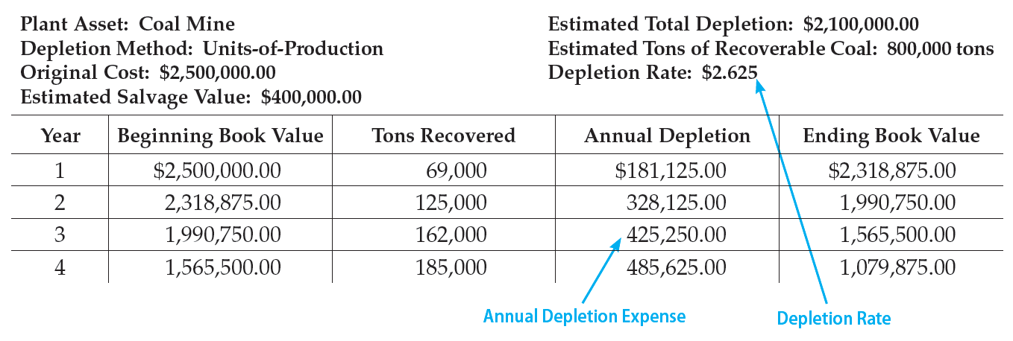
Calculating Depletion on Natural Resources
Lesson 7-4
LO6
The decrease in the value of a plant asset because of the removal of a natural resource is called depletion.
© 2015 Cengage Learning. All Rights Reserved.
© 2015 Cengage Learning. All Rights Reserved.

Slide 12
Calculating Depletion on Natural Resources
Lesson 7-4
LO6
Original Cost | - | Estimated Salvage Value | = | Estimated Value of Coal
$2,500,000 | - | $400,000 | = | $2,100,000
Estimated Value of Coal | ÷ | Estimated Tons of Coal | = | Depletion Rate
$2,100,000 | ÷ | 800,000 tons | = | $2.625/ton
© 2015 Cengage Learning. All Rights Reserved.

Slide 13
Lesson 7-4 Audit Your Understanding
Lesson 7-4
1. Which depreciation method ignores the estimated salvage value?
ANSWER
Declining-balance and MACRS.
© 2015 Cengage Learning. All Rights Reserved.
© 2015 Cengage Learning. All Rights Reserved.

Slide 14
Lesson 7-4 Audit Your Understanding
Lesson 7-4
2. What is the basis for the units-of-production method of calculating depreciation?
ANSWER
The amount of use the asset receives, measured in hours, units, weight, or volume.
© 2015 Cengage Learning. All Rights Reserved.
© 2015 Cengage Learning. All Rights Reserved.

Slide 15
Lesson 7-4 Audit Your Understanding
Lesson 7-4
3. Describe the types of assets in the MACRS five- and seven-year property classes.
ANSWER
The five-year property class includes cars, general purpose trucks, computers, manufacturing equipment, and office machinery. The seven-year property
class includes office furniture and fixtures.
© 2015 Cengage Learning. All Rights Reserved.
© 2015 Cengage Learning. All Rights Reserved.

Slide 16
Lesson 7-2 Audit Your Understanding
Lesson 7-4
4. How does a mining company calculate the amount of depletion for a year?
ANSWER
Tons of material mined times the depletion rate equals annual depletion expense. The depletion rate is calculated by dividing the estimated total value of the mineral resource by the estimated number of tons of the mineral to be recovered.
© 2015 Cengage Learning. All Rights Reserved.
© 2015 Cengage Learning. All Rights Reserved.

